Slide 1
Air masses are large zones of air that have uniform temperature and moisture (humidity) characteristics. They cover a very large geographic area.
Air masses adopt the characteristics of the geography over which they form.
Air must sit for weeks over the geographic area.
Air masses can move from their sources to other places by prevailing winds and global atmospheric circulation.

Slide 2
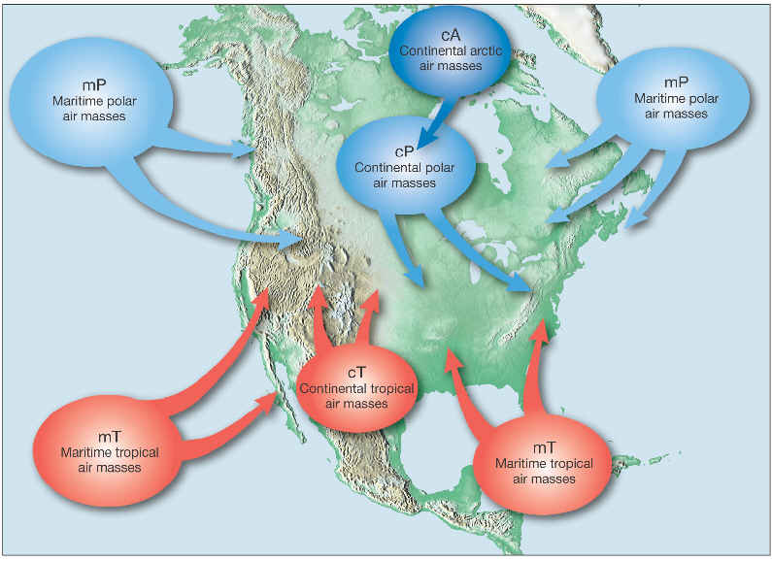

Slide 3
Continental: air masses that form over land. Continental air masses are dry (low humidity).
Maritime: Air masses that form over oceans. Marine air masses are moist (very humid).
Tropical: Air masses that form near the equator in hot temperatures.
Polar: Air masses that form in the subarctic regions and are cold.
Arctic: Air masses that form in the arctic areas and are very cold.

Slide 4
Low pressure systems will produce rainy weather, and sometimes strong and destructive weather.
Rising wind systems with convergence at the surface.
Unstable atmosphere.
High pressure systems will produce clear and calm weather, with little cloud cover and gentle winds.
Descending wind systems with divergence at the surface.
Stable atmosphere.
Centers of air masses.

Slide 5
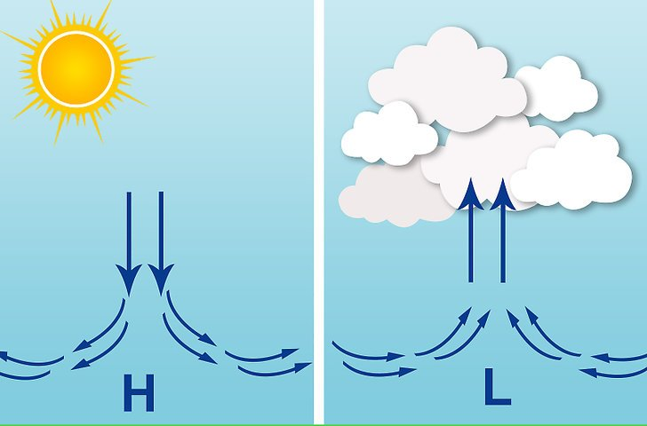
High pressure zone is formed by descending air. Air mass is moving downward towards the ground. Stable air.
Low pressure zone is formed by ascending air. Air mass is moving up, higher into the atmosphere. Unstable air.

Slide 6
Convergent uplift: Winds from opposing directions converge (come together) at the surface. When the opposing winds collide, they displace the air upwards.
Converging winds perpetuate an already established low pressure system.
Convective uplift: The Earth’s surface becomes very hot. Heat from the surface is transferred to the air above, causing the air to get hot. The hot air expands, becomes less dense, and rises very quickly.
Converging winds start flowing into the low pressure system.
This creates an unstable atmosphere.

Slide 7
Convergent uplift

Slide 8
Convective uplift

Slide 9
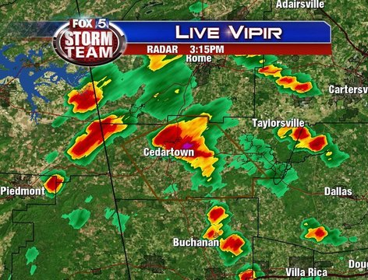
Radar image of the unstable humid atmosphere with thunderstorms. Summer afternoons supercell thunderstorms.

Slide 10
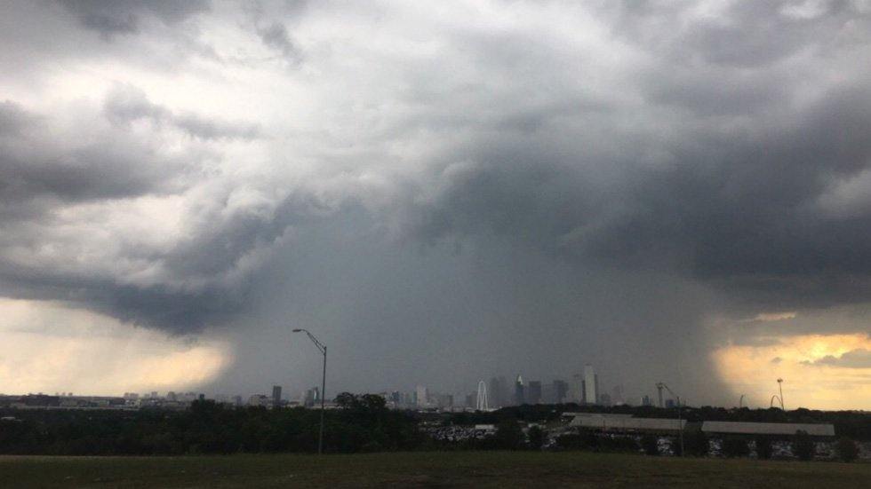
Convective uplift usually occurs on hot sunny days in summer. As the heated and unstable air rises, it will create afternoon rainstorms and possible “supercell thunderstorms” in the afternoon.

Slide 11
Orographic uplift: Winds and air are forced upward along the windward slopes of mountain ranges. Fog and rain forms as the air is pushed upward.
Windward side of the mountain range is the rainy side.
Leeside of the mountain range is the dry side.
Frontal uplift: Two air masses of different temperature and moisture characteristics collide. The lesser dense air mass is pushed upwards by the denser air mass.
Frontal boundaries are areas of rain and possible violent weather.
Fronts produce linear bands of rain and sometimes violent weather.

Slide 12
Orographic uplift
Rainy side
Dry side

Slide 13
Rainy side (windward)
Desert and very dry (leeside)
Cascade Mts.

Slide 14
Tacoma, WA 47º N
Richland, WA 46º N
Much rain on windward side
Very little rain on leeside

Slide 15
Frontal uplift

Slide 16
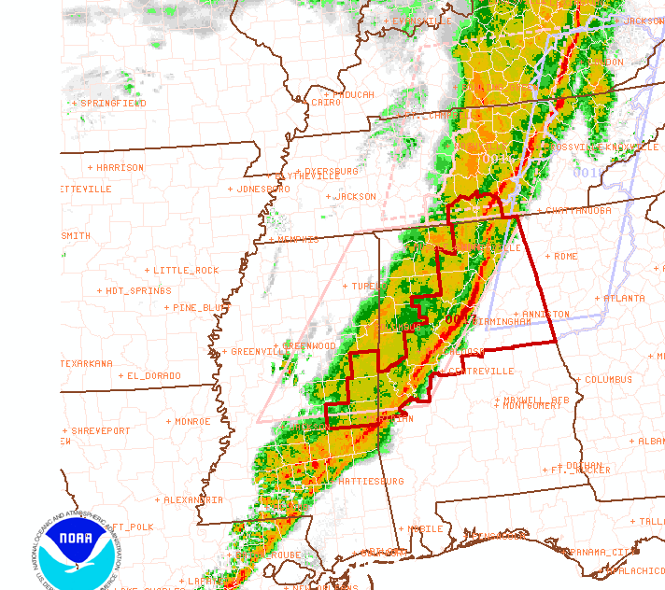
Radar image of a cold front moving through the southeast United States.
Cold air mass moving east pushing into the warm air mass
Warm air mass moving slow t the east.

Slide 17
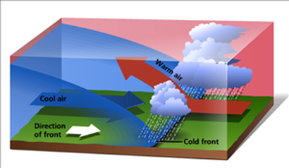
Cold Front

Slide 18
Cold Front
Dry colder air mass is moving faster than the warmer humid air mass.
Cold fronts move very fast.
Colder air mass pushes the warmer air mass upward very quickly.
Linear band of moving thunderstorms.
Strong winds, thunderstorms, and heavy rain just behind the front of the front. (squall line)
Possible hail and tornadoes if the cold front is very strong.

Slide 19
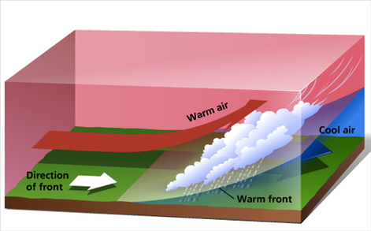
Warm Front

Slide 20
Warm Front
Humid warmer air mass is moving faster than the colder drier air mass.
Moves slower than cold front.
Warmer air mass gradually rises upward and over the colder air mass.
Wider band of slower moving rain storms. Usually gentle to moderate rain without severe weather.

Slide 21
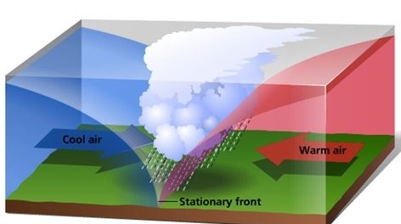
Stationary Front

Slide 22
Stationary Front
A warm air mass and a cold air mass are moving into each other, and neither displaces the other.
Rain will be created along the stationary front boundary because the cooler air mass lowers the temperature of the warmer air next to it to the dew point temperature.
Moderate rain that will last for days.
Usually no severe weather.

Slide 23
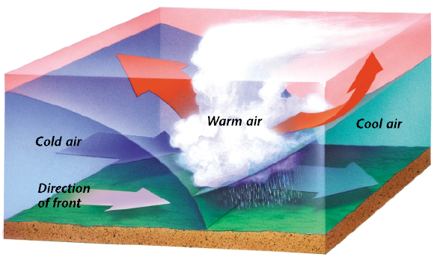
Occluded Front

Slide 24
Occluded Front
A faster moving cold front overtakes a slower moving warm front. The entire warm air mass is pushed upward and over the cold air mass.
Heavy rain and storms.
Possible severe and violent weather.

Slide 25
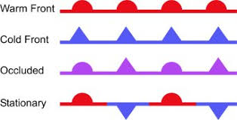
Weather Map Symbols for fronts.
The lobes and arrows point in the direction that the air masses move.

Slide 26
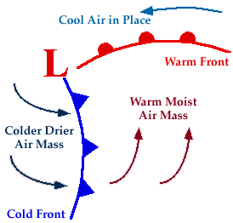

Slide 27
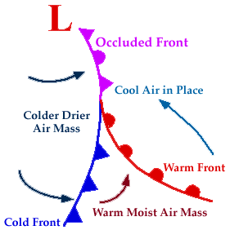

Slide 29
The front edge of the cold front is called the squall line. The squall line will have the strongest winds and the most severe weather like thunderstorms and tornadoes.

Slide 30
Radar image of a cold front moving through the southeast United States.

Slide 31
Radar map of an advancing cold front.

Slide 32
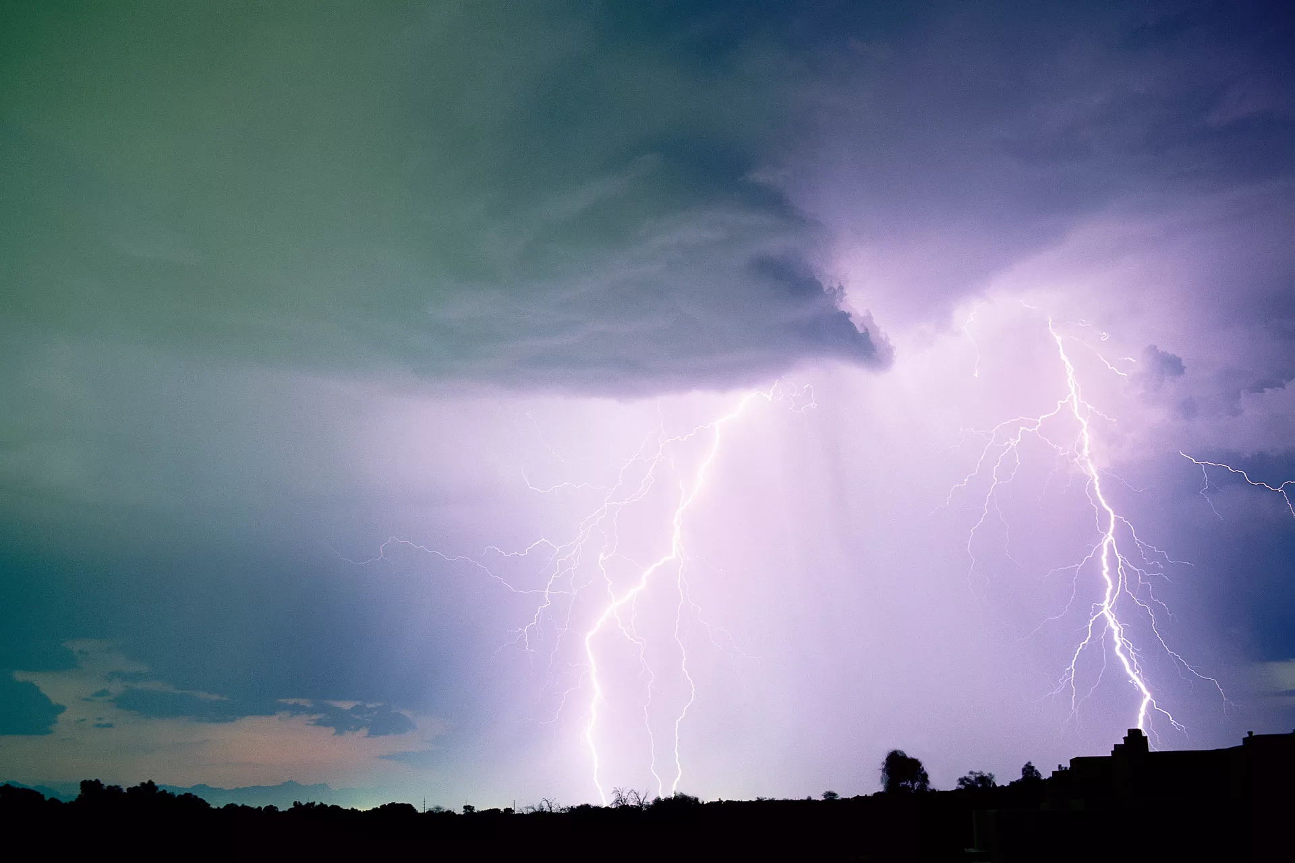
Thunderstorms are very strong rain storms that have lighting, thunder, and strong winds. Some thunderstorms have hail and other violent weather. Thunderstorms happen at strong low pressure.

Slide 33
Thunderstorms start as fast rising unstable air (updrafts) that rises very high into the atmosphere where it is very cold.
The air cools fast and becomes dense. Rain will form because the temperature of the air is below the dew point temperature.
The colder air will sink fast back to the Earth’s surface (downdrafts).

Slide 34
Downdrafts
Updrafts
Heavy rain and strong winds at the front side of the storm.

Slide 35
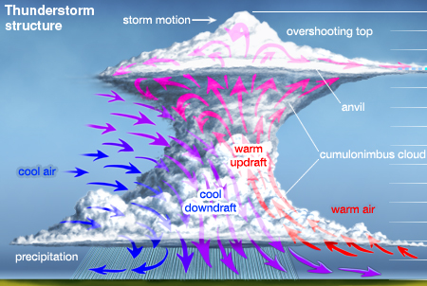

Slide 36
This is a cumulonimbus cloud created by convective uplift.
Updrafts pull the warm unstable air upward where it cools into the very large cloud.
This is about to become a new thunderstorm.

Slide 37
The close-up of the bottom of a supercell thunderstorm cloud will have rotation. This rotating cloud is called a mesocyclone. The thunderstorm will be very severe.

Slide 38
Lightning is a rapid discharge of static charge (electricity) from cloud to cloud, or from cloud to ground.

Slide 39
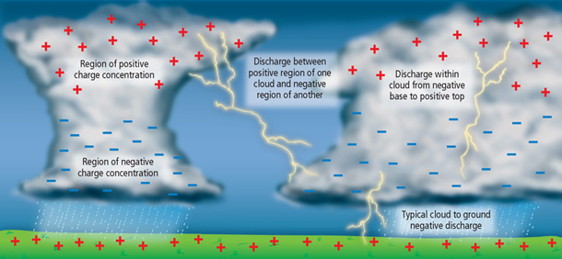
Electrons separate from water atoms. The electrons (negatives) accumulate in the bottom of the clouds. Positive charges accumulate at the top of the clouds.
The electrons (negatives) discharge or jump to the positives. They heat up the air they pass through making the white or yellow streaks.

