Slide 1

Meteorology: The study of weather.
Climatology: The study of climate.
Weather is the short-term physical conditions of the atmosphere.
Weather is based on minutes to hours to days up to weeks.
Air temperature
Cloud cover & precipitation
Storms and winds

Slide 2
Within the troposphere, air temperature decreases (gets colder) with increasing altitude upward from mean sea level. This is called the normal lapse rate.
On average, the air temperature decreases by 6.4º C for every 1000 m increase in altitude.
The air temperature also gets warmer by 6.4ºC for every 1000 m decrease in altitude.

Slide 3
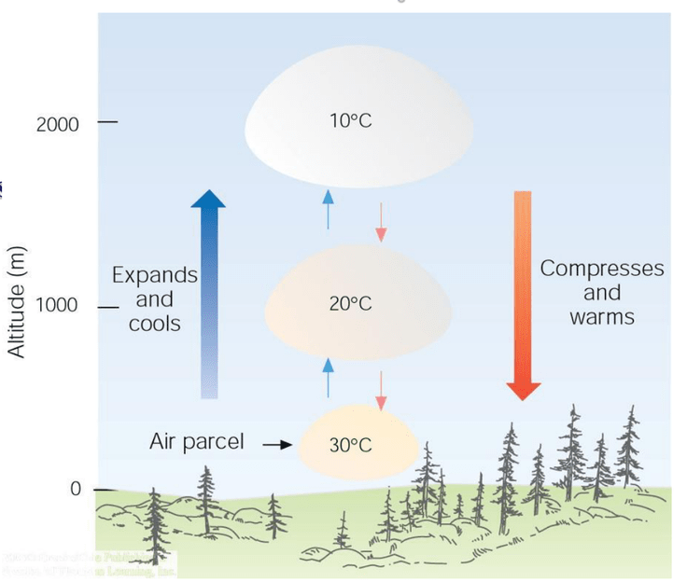

Slide 4
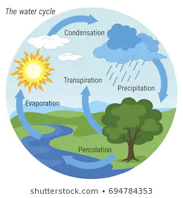

Slide 5
If water gains heat from the environment or from the air, the phases of water will change to a more energetic form.
Evaporation: Liquid H₂O + Heat → H₂O vapor
Sublimation: ICE + Heat → H₂O vapor
Melting: ICE + Heat → H₂O liquid
The gain of heat by water in the atmosphere will cause the air temperature to get cooler.

Slide 6
If water releases heat to the environment and air, the phases of water will change to a less energetic form.
Condensation: H₂O vapor → liquid H₂O + Heat
Deposition: H₂O vapor → ICE + Heat
Freezing: Liquid H₂O → ICE + Latent Heat
The release of heat by water in the atmosphere will cause air temperature to get warmer.

Slide 7
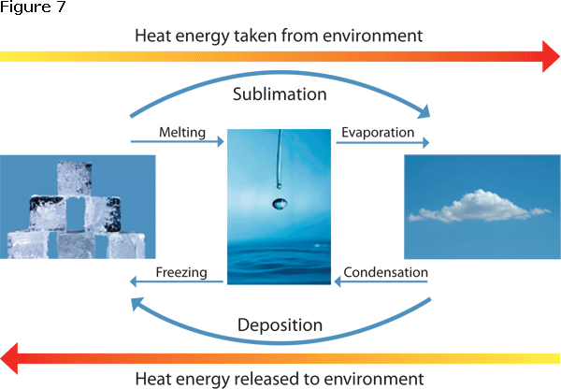
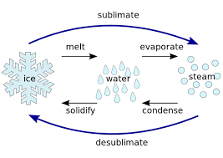
Sublimation
vapor
deposition

Slide 9
Humidity: The quantity of water vapor in the atmosphere relative to the air’s saturation point at a given air temperature.
The saturation point is the maximum amount of water vapor that a volume of air can hold at a given temperature.
The air is undersaturated if the quantity of water vapor in the air is less than the saturation point. (the air can hold more water vapor).
If the air is saturated, the air is holding the maximum amount of water vapor it can hold. (it cannot hold more)

Slide 10
Water vapor

Slide 11
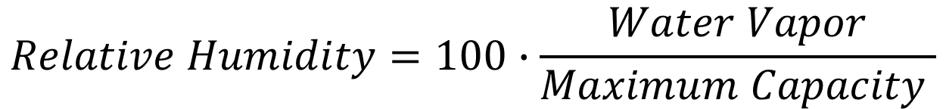
Relative humidity is reported as a percentage.
RH = 100%, the air is saturated and holding the maximum amount of water vapor it can hold.
RH < 100%, the air is undersaturated. More evaporation can happen and the air can gain more water vapor.
$$Relative Humidity=100∙\frac{Water Vapor}{Maximum Capacity }$$

Slide 12
Dew Point Temperature is the temperature of air at which a cooling air mass will reach saturation (100% humidity).
At the dew point temperature, the amount of water vapor in the air is exactly at the maximum amount that the air can hold at that temperature.
Remember, as air cools, the volume of the air contracts and the air will be able to hold lesser and lesser water vapor.

Slide 13
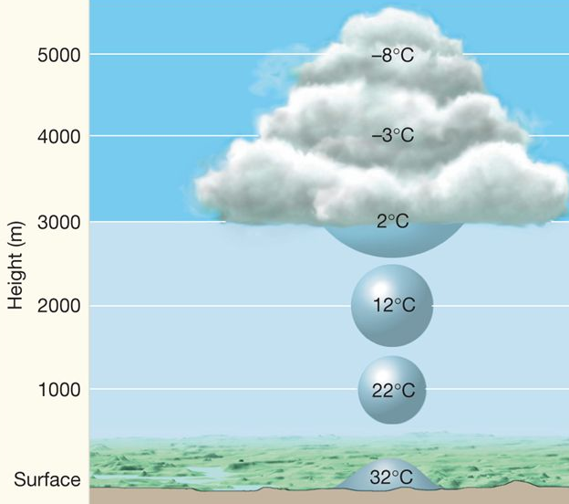
Lifting condensation level (LCL) is the altitude or elevation at which a rising air mass reaches the dew point temperature.
Air temperature decreases as air rises. Eventually it will cool to the dew point temperature.
The air cannot hold any more water vapor because is it at saturation.
Clouds start to form.
LCL

Slide 14
Saturation is reached at the dew point temperature (at the LCL)
Water vapor
Temperature decreases as air rises

Slide 15
Clouds are buoyant masses of aerosols in Earth’s atmosphere.
Water-based clouds are made of very tiny floating water droplets or ice crystals that are too light in mass to fall to the Earth.
Clouds form when water vapor condenses to very tiny water droplets when an air mass cools to the dew point temperature and the air becomes saturated.
Clouds that form at ground-level are called fog.

Slide 16
There are four classes of clouds
Cumuliform clouds (cumulus clouds)
Stratiform clouds (stratus clouds)
Cirriform clouds (cirrus clouds)
Nimbus clouds
Each type of cloud forms at different altitudes under different weather conditions.

Slide 17
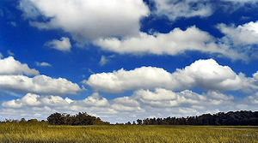
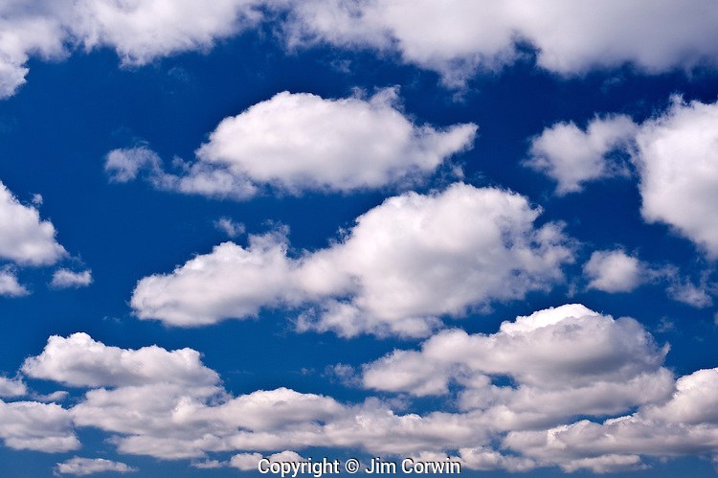
Cumuliform clouds (or cumulus clouds) are clouds that are 3-dimensional clouds with a “puffy”, “cotton-like” or “fluffy” appearance.
Cumulus clouds are low altitude clouds.

Slide 18
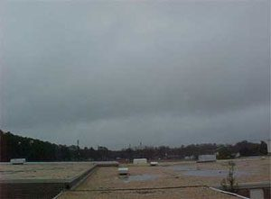
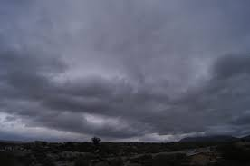
Stratiform clouds (or stratus clouds) are clouds are clouds that look like “layers” .
Some are ceiling clouds. Clouds that block out sunlight and gray the sky.

Slide 19
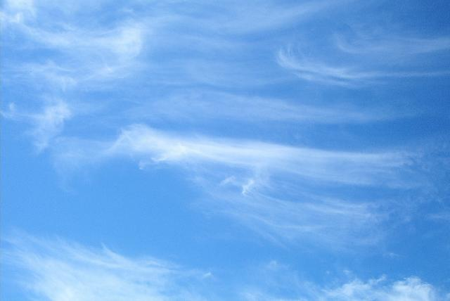
Cirriform clouds (or cirrus clouds) are clouds are clouds that look “curly” or “whispy”.
Cirrus clouds are very high in the atmosphere where there is little humidity. Cirrus clouds tend to be made of tiny ice crystals.

Slide 20
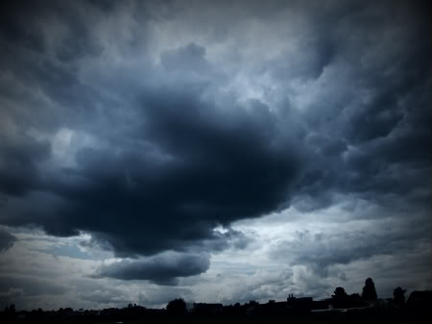
Nimbus clouds are rain clouds. They tend to be cumulus clouds with a dark gray appearance.

Slide 21
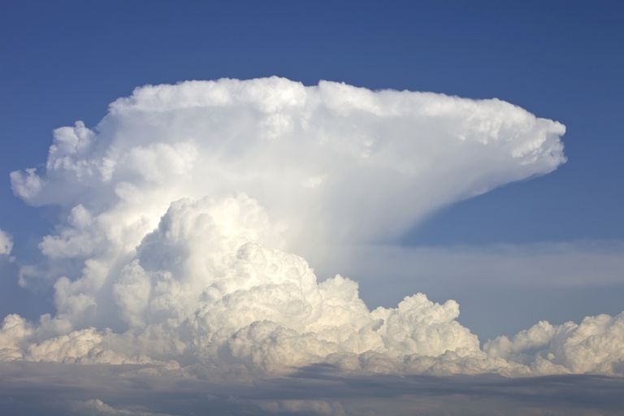
Cumulonimbus clouds column clouds that form because very unstable humid air is rising very, very fast (convective uplift making strong low pressure). As they form, very strong thunderstorms with damaging winds form. They are sometimes called anvil clouds because of their shapes.

Slide 22
Fog is clouds that form at ground-level.
The air temperature near the ground has cooled to the dew point temperature.
The air reaches 100% relative humidity.
Water vapor condenses billions of tiny water droplets that float in the air.
Fog reduces visibility.

Slide 23
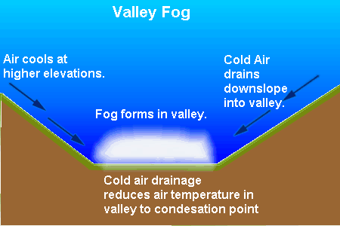

Slide 24
Valley fog: Colder denser air sinks into the valleys between mountains. The colder air cools the air in the valley to temperatures below the dew point temperature. Fog forms.

Slide 25
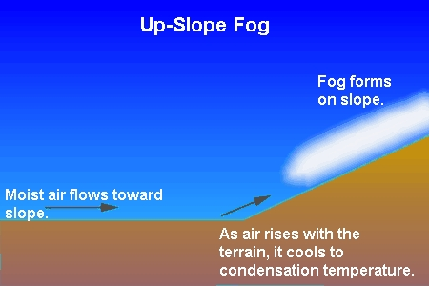

Slide 26
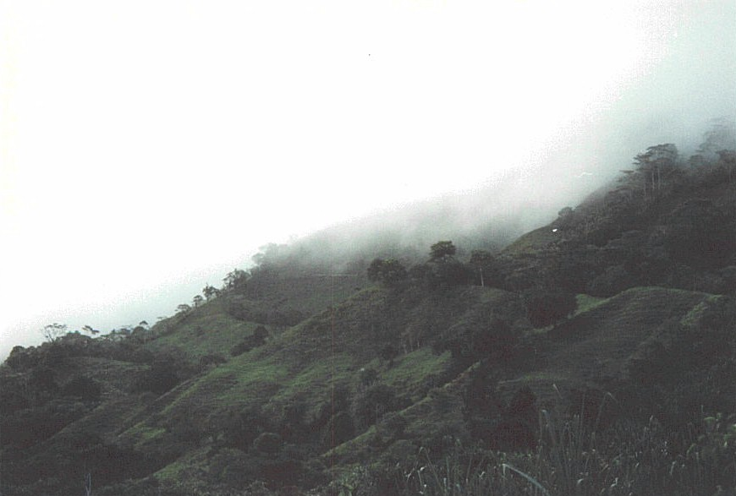
Upslope fog: Humid air rises up mountain slopes and cools with increasing elevation. Eventually, the rising air cools to the dew point temperature (at the LCL) forming fog. Upslope fog tends to be near the summits of high mountains.

Slide 27
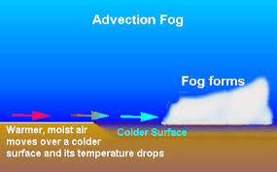

Slide 28
Advection fog: A warmer humid air mass (from over land) is moved by winds over a colder surface (like a lake or ocean). The air temperature rapidly cools to the dew point temperature and fog forms.

Slide 29
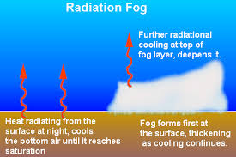

Slide 30
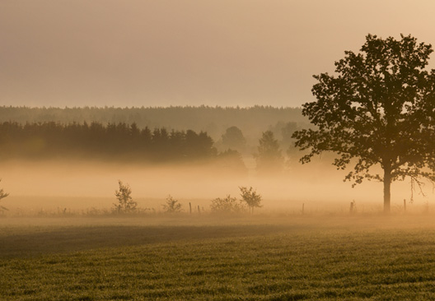
Radiation fog: Earth’s surface releases infrared (heat) upward to the atmosphere and cools. The surface cools quickly as it loses heat. Next, the air above the surface cools to temperatures below the dew point temperature. Fog forms.

Slide 31
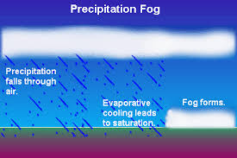

Slide 32
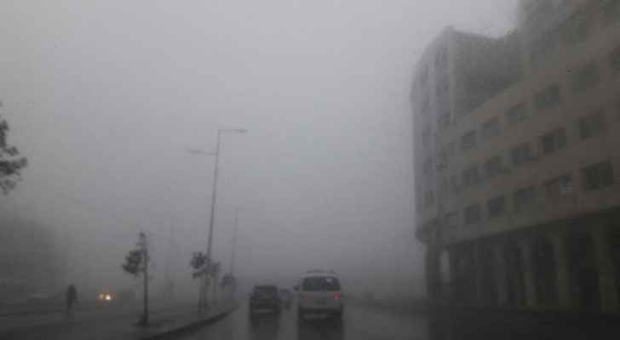
Precipitation fog: Forms during rain storms. As rain falls, the raindrops begin to evaporate into water vapor before they hit the ground. The water vapor condenses into ground level clouds as the air cools as the water evaporates.

