Slide 1
Meteorology: The study of weather.
Climatology: The study of climate.
Weather is the short-term physical conditions of the atmosphere.
Weather is based on minutes to hours to days up to weeks.
Air temperature
Cloud cover & precipitation
Storms and winds

Slide 2
Climate is the long-term physical conditions of the atmosphere based on geographic location.
Climate includes seasonal variations and year-to-year atmospheric conditions.
Amount of sunlight
Seasonal temperatures and yearly average temperatures.
Total amount of precipitation

Slide 3
Air is the inert mixture of gases in our atmosphere.
Air temperature is warmest near the Earth’s surface because sunlight warms the Earth’s surface, and heat is transferred to the air above to make it warmer.
Air temperature in the troposphere decreases with increasing altitude away from the Earth’s surface.

Slide 4
Within the troposphere, air temperature decreases (gets colder) with increasing altitude upward from mean sea level. This is called the normal lapse rate.
On average, the air temperature decreases by 6.4º C for every 1000 m increase in altitude.
The air temperature also gets warmer by 6.4ºC for every 1000 m decrease in altitude.

Slide 5
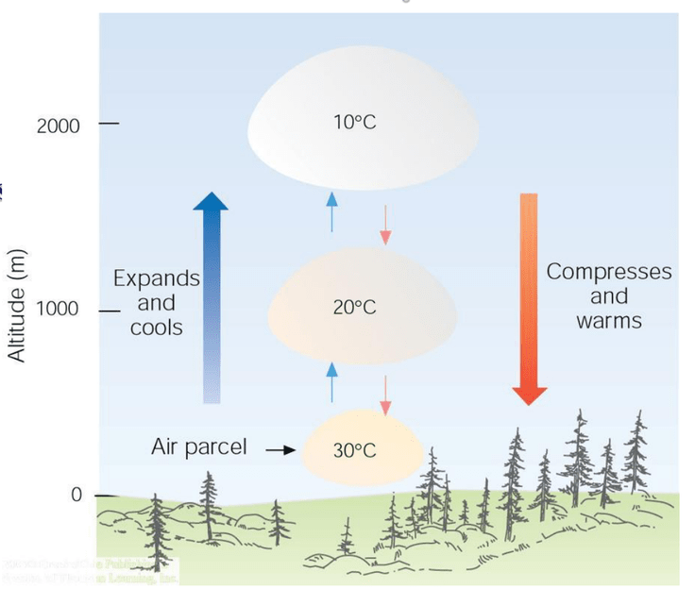

Slide 6
When air gains heat energy, air temperature increases. This causes air to expand in volume, become less dense, and rise upward.
As the air expands and rises upward, it cools off. The temperature of the air decreases.

Slide 7
When air releases heat energy, air temperature decreases. This causes air to contract in volume, become less dense, and sink downward.
As the air contracts and sinks back to the Earth’s surface, the air warms.

Slide 8
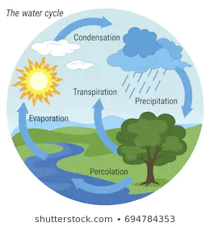

Slide 9
Water Cycle: A series of connected processes that move water between the Earth’s crust, the oceans, and the atmosphere.
The energy that drives the water cycle comes from the sun.
The energy from sunlight adds heat to the oceans and surface ocean, which causes evaporation.
The movement of the atmosphere carries water vapor and transforms water to precipitation.

Slide 10
If water gains heat from the environment or from the air, the phases of water will change to a more energetic form.
Evaporation: Liquid H₂O + Heat → H₂O vapor
Sublimation: ICE + Heat → H₂O vapor
Melting: ICE + Heat → H₂O liquid
The gain of heat by water in the atmosphere will cause the air temperature to get cooler.

Slide 11
If water releases heat to the environment and air, the phases of water will change to a less energetic form.
Condensation: H₂O vapor → liquid H₂O + Heat
Deposition: H₂O vapor → ICE + Heat
Freezing: Liquid H₂O → ICE + Latent Heat
The release of heat by water in the atmosphere will cause air temperature to get warmer.

Slide 12
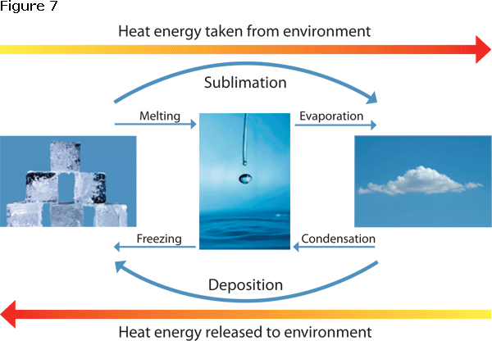
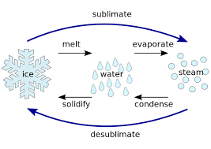
Sublimation
vapor
deposition

Slide 14
Hotter Air Temperatures will cause water to evaporate faster and add more water vapor to the air.
Hot air can hold more water vapor.
Volume of air is larger, there is more room for water to evaporate and fill the space.
Colder Air Temperatures will cause water to evaporate slower and add less water vapor to the air.
Cold air holds less water vapor.
Volume of air is smaller, there is less room for water to evaporate and fill the space.

Slide 15
Humidity: The quantity of water vapor in the atmosphere relative to the air’s saturation point at a given air temperature.
The saturation point is the maximum amount of water vapor that a volume of air can hold at a given temperature.
The air is undersaturated if the quantity of water vapor in the air is less than the saturation point. (the air can hold more water vapor).
If the air is saturated, the air is holding the maximum amount of water vapor it can hold. (it cannot hold more)

Slide 16
Hypothetical comparison of dry air and humid air
Mass of air = 1.2 kg
Mass of H₂O = 0 g
Volume = 1 m³
Density = 1.2 kg/m³
Mass of air = 1.2 kg
Mass of H₂O = 20 g
Volume = 1 m³
Density = 1.22 kg/m³
Dry Air Mass
Humid Air Mass

Slide 17
Water vapor

Slide 18
At 25°C, air can hold the maximum of 23 grams of water vapor per
1 m³ of air.
Water vapor
If the air at 25°C has less than 23 grams of water vapor per 1 m³, the air is undersaturated.
If the air at 25°C has exactly 23 grams of water vapor per 1 m3, the air is saturated.

Slide 19
At 10°C, air can hold the maximum of 9.5 grams of water vapor per
1 m³ of air.
Water vapor
If the air at 10°C has less than 9.5 grams of water vapor per 1 m³, the air is undersaturated.
If the air at 10°C has exactly 9.5 grams of water vapor per 1 m³, the air is saturated.

Slide 20
At 0°C, air can hold the maximum of 4.5 grams of water vapor per
1 m³ of air.
Water vapor
If the air at 0°C has less than 4.5 grams of water vapor per 1 m³, the air is undersaturated.
If the air at 0°C has exactly 4.5 grams of water vapor per 1 m³, the air is saturated.

Slide 21
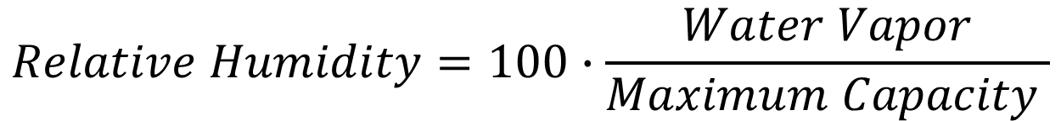
Relative humidity is reported as a percentage.
RH = 100%, the air is saturated and holding the maximum amount of water vapor it can hold.
RH < 100%, the air is undersaturated. More evaporation can happen and the air can gain more water vapor.

Slide 22
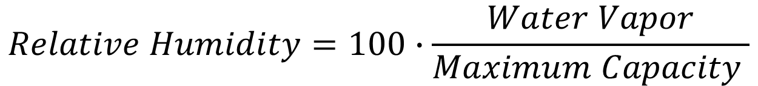
Relative humidity is defined as the amount of water vapor in the air divided by the maximum capacity of water vapor that an air mass may hold at a given temperature.
Relative humidity is reported as a percentage.
RH = 100%, the air is saturated and holding the maximum amount of water vapor it can hold.
RH < 100%, the air is undersaturated. More evaporation can happen and the air can gain more water vapor.

