Slide 1
Dr. Ritchie’s Space Vacation
Up, Up…and Away!

Slide 2
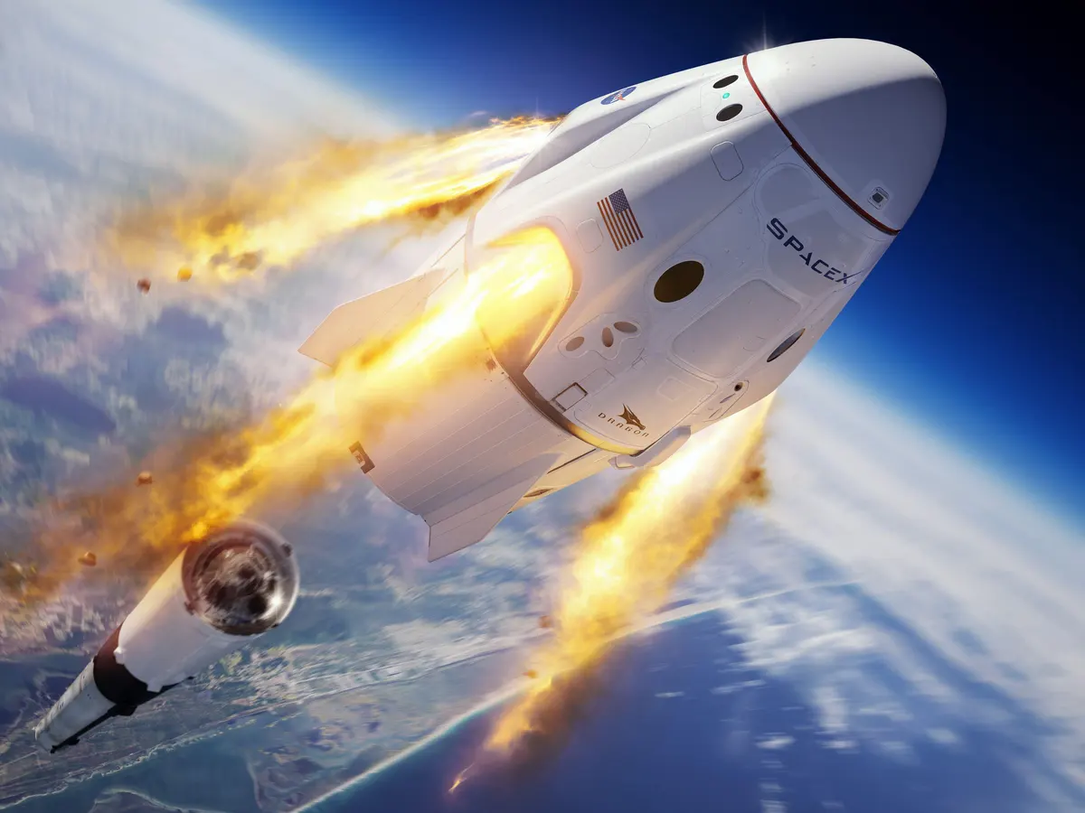
We took off from Earth on our week-long space vacation. The blastoff was rough. And as I was looking back to see the Earth moving away from us, I realized that I forgot to pack my toothbrush.
This is your captain speaking. We are now cruising at 50,000 km/hr at an altitude of 60,000 miles.

Slide 3
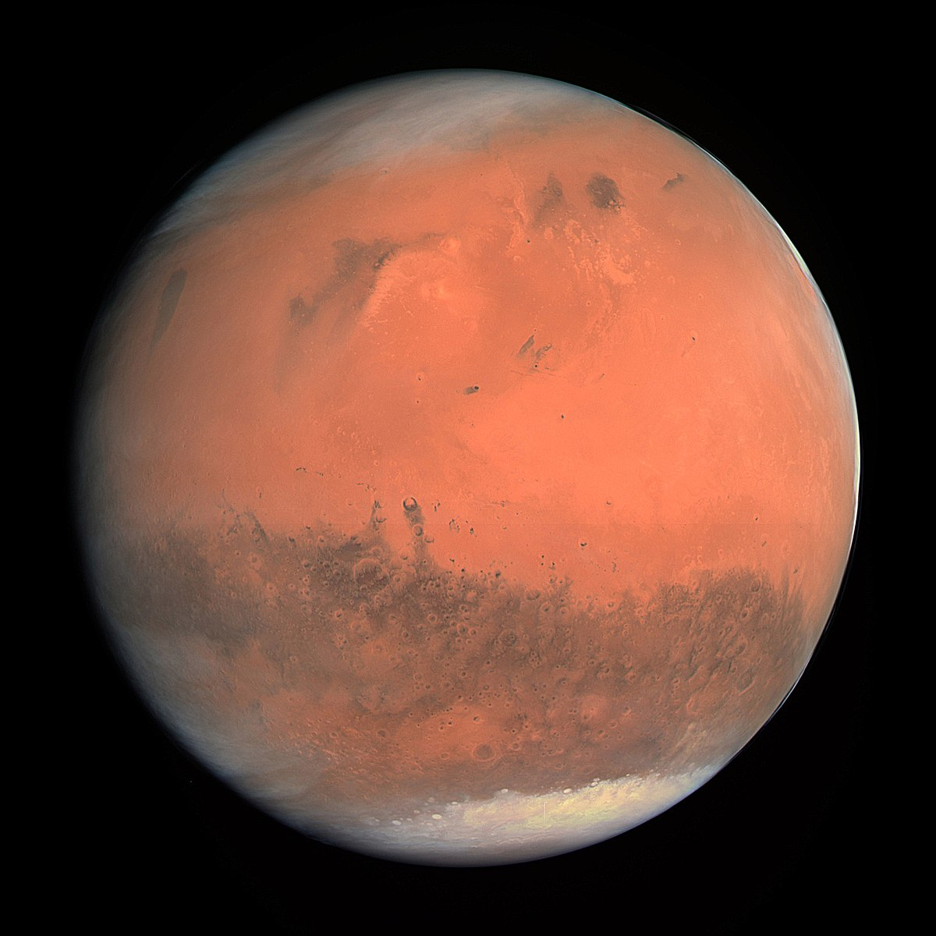
Our first stop was a guided tour of planet Mars, the red planet.
Mars was red because its past atmosphere had oxygen, and the oxygen rusted the iron in the soil and rocks. Everything on Mars was red like pizza sauce. I miss pizza.

Slide 4
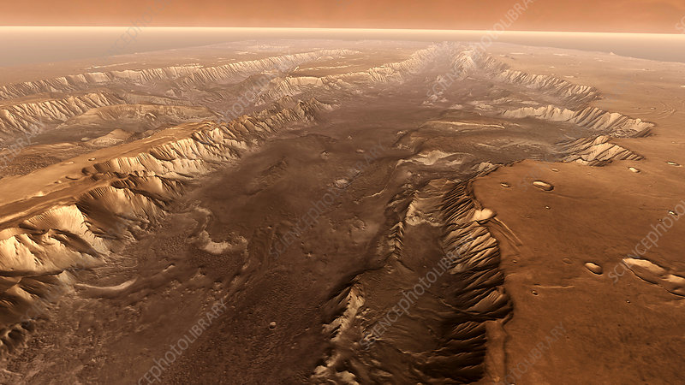
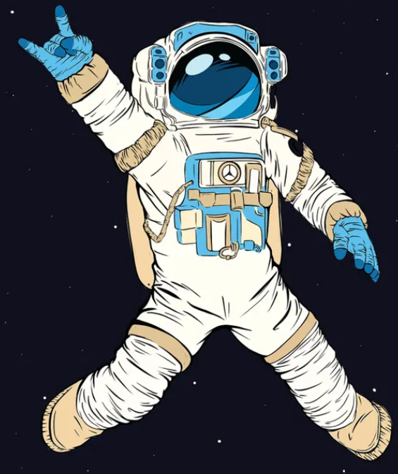
We took selfies on the rim of Valles Marineris. Valles Marineris is a Martian canyon system longer and deeper that the Grand Canyon. I threw a rock into Valles Marineris. It fell and fell and fell. It was deep!
Look at me! No hands!

Slide 5
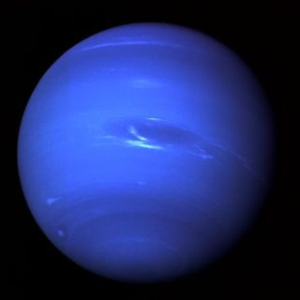
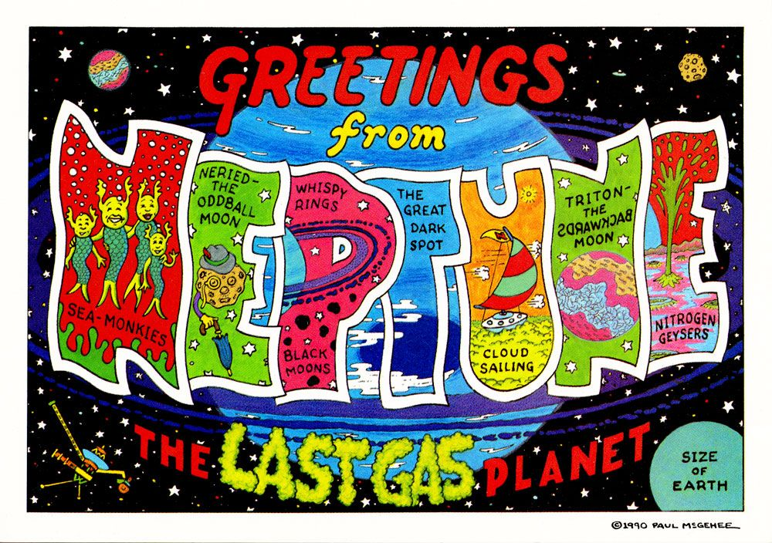
Our next stop was the Planet Neptune. It seemed like it took years to get there. I needed to put on a sweater over my spacesuit, it was very, very cold this far away from the Sun. The sun looked like a dot from here.

